Slide 1

DBMS PROJECT
ON PLAYSTORE
G.AKSHAY
M.ABHI SAI

Slide 2


PROBLEM STATEMENT
The project is about managing database in Play Store. It covers collecting data on categories of applications and collecting ratings, size, reviews, number of downloads, description, price, offers of respective apps and userId, password, search history, updates, purchases, wishlist, etc for respective users. It also covers collecting data on books and audiobooks, details of the application creators, etc.

Slide 3
ASSUMPTIONS
One developer can develop any number of games but one game can be developed by only one developer.
One publisher can develop any number of books but one book can be published by only one publisher.
Rating_id can be same for different applications but different for one particular application .
An app can have multiple updates and subscriptions but user can buy one or more subscriptions among them.
Any developer and publisher can have multiple email id

Slide 4
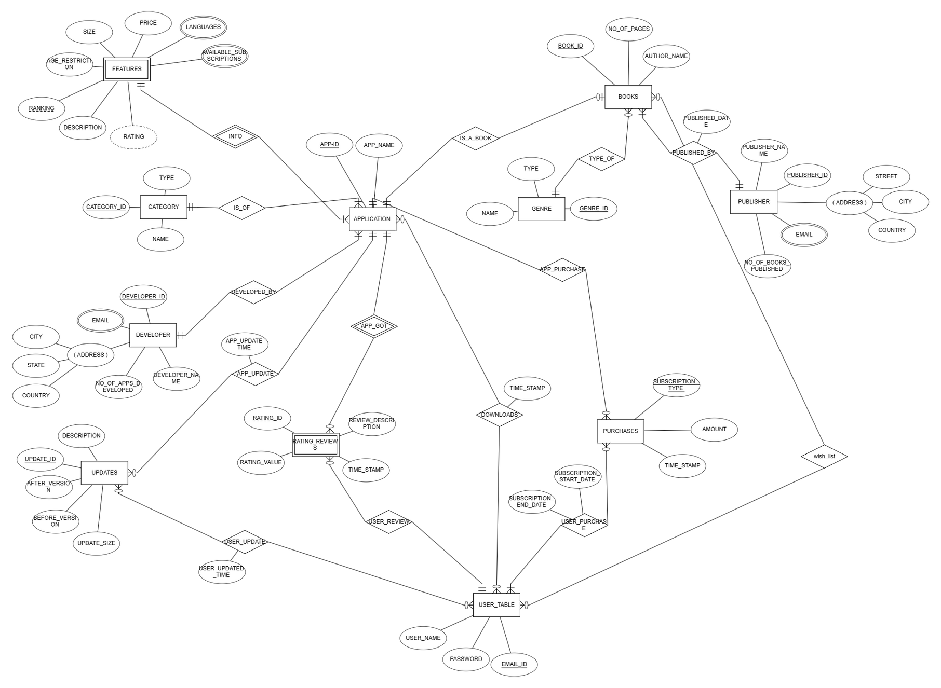
E-R DIAGRAM

Slide 5
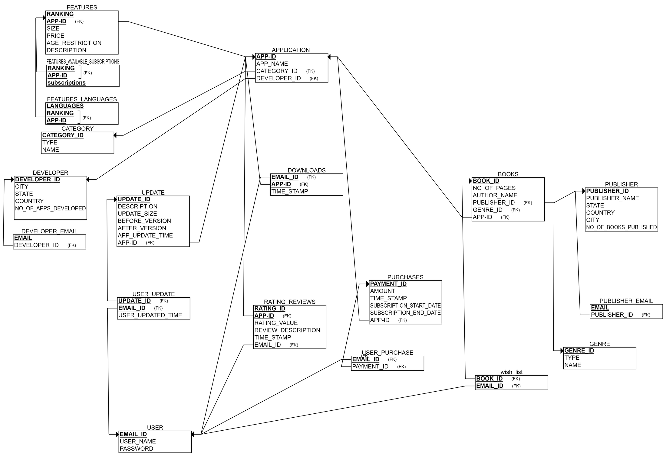
RELATIONAL SCHEMA

Slide 6
NORMALISATION

Slide 7
NORMALISATION
1 NF
Creative Idea
A relation is in 1NF if it contains an atomic value.
2 NF
1NF and
all non-key attributes are fully functional dependent on the primary key.
2NF all non-key attributes are fully functional dependent on the primary key.

Slide 8
NORMALISATION
3 NF
2NF all non-key attributes are fully functional dependent on the primary key.
BCNF
Creative Idea
A stronger definition of 3NF is known as Boyce Codd's normal form.

Slide 9
NORMALISATION
Tables:-category,application,features,publisher_email,category,books,Genre,user,wish_list,features_languages,features_available_subscriptions,developer_email,updates,user_update,purchases,user_purchase,Rating_reviews,Downloads, are already in BCNF because
they dont contain any multi valued attributes
there are no partial dependencies
no transitive dependencies
every dependency has only super key determining
other attributes

Slide 10
NORMALISATION
TABLE features contains multi-valued attributes (languages,available_subscriptions) (so it is not in 1NF) .so make separate tables Features_languages and features_available_subscriptions
TABLE Developer,publisher contains multi-valued attributes (email) (so it is not in 1NF) .so make separate table as developer_email,publisher_email.

Slide 11
NORMALISATION
TABLE Developer is not in 3NF because only developer_id is primary key and prime attribute
CITY -> COUNTRY (city is not canditate key and country is not prime)
STATE -> COUNTRY (city is not canditate key and country is not prime)
CITY -> STATE (city is not canditate key and country is not prime)

Slide 12
NORMALISATION
SO TO MAKE DEVELOPER TO 3NF WE HAVE TO DECOMPOSE THOSE TO DEVELOPER,CITY_TABLE,STATE_TABLE
DEVELOPER :
CREATE TABLE DEVELOPER(
DEVELOPER_ID INT PRIMARY KEY,
DEVELOPER_NAME VARCHAR(20),
NO_OF_APPS_DEVELOPED INT,
CITY VARCHAR(20),
FOREIGN KEY (CITY) REFERENCES CITY_TABLE(CITY)
);

Slide 13
NORMALISATION
CITY_TABLE:
CREATE TABLE CITY_TABLE(
CITY VARCHAR(20) PRIMARY KEY ,
STATE VARCHAR(20) ,
FOREIGN KEY (STATE) REFERENCES STATE_TABLE(STATE)
);
STATE_TABLE:
CREATE TABLE STATE_TABLE(
STATE VARCHAR(20) PRIMARY KEY,
COUNTRY VARCHAR(20)
);

Slide 14
NORMALISATION
TABLE PUBLISHER is not in 3NF because only PUBLISHER_ID is primary key and prime attribute
CITY -> COUNTRY (city is not canditate key and country is not prime)
STATE -> COUNTRY (city is not canditate key and country is not prime)
CITY -> STATE (city is not canditate key and country is not prime)
WE CAN MAKE IT 3NF AS BEFORE

Slide 15
RELATIONAL SCHEMA
AFTER NORMALISATION

Slide 16
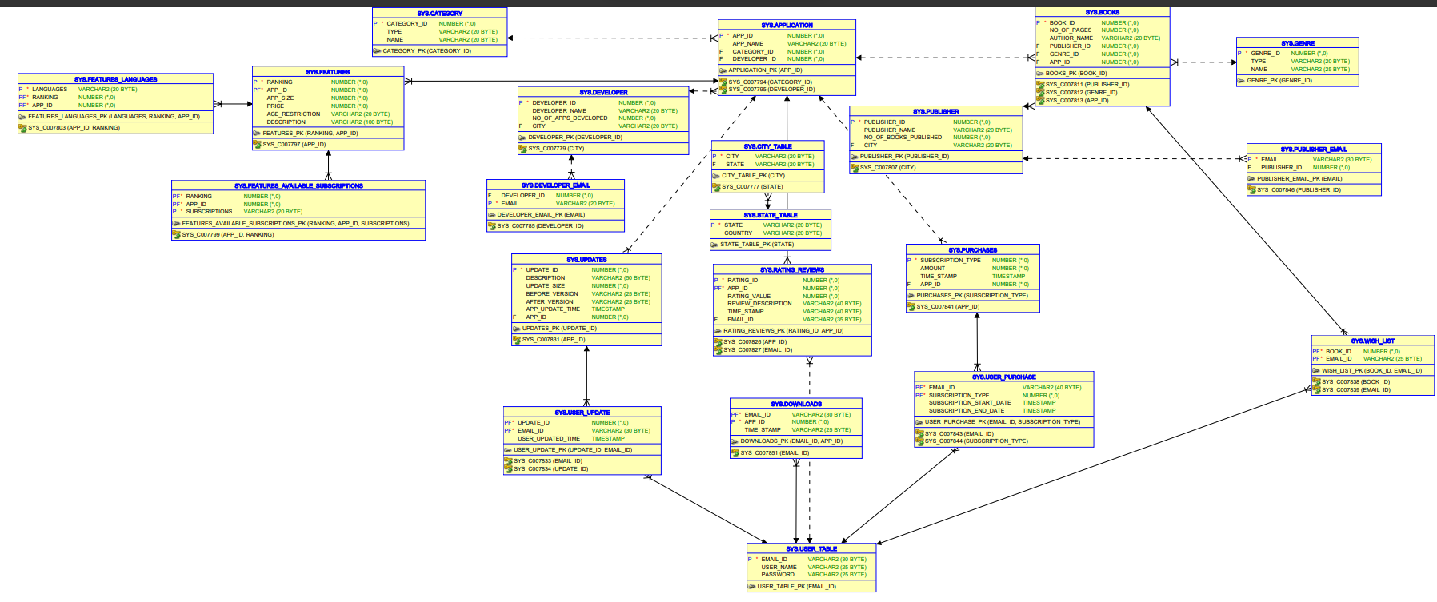


Slide 17
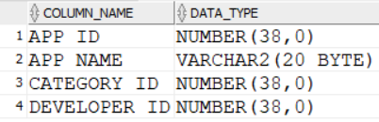
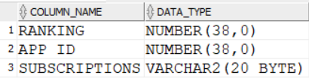
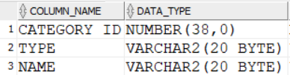
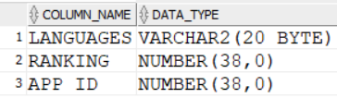
TABLES
Features_available_
subscription:
Application :
Category:
Features_languages

Slide 18
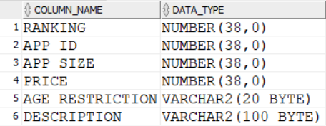
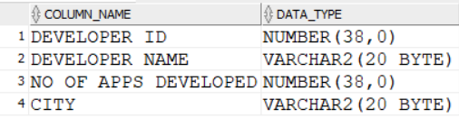


TABLES
Features:
Developer:
Developer_email:
City_table:

Slide 19


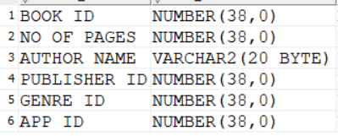

TABLES
State_table :
PUBLISHER_EMAIL:
BOOKS:
GENRE:

Slide 20
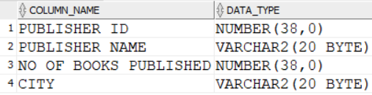
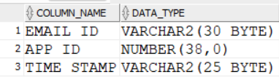
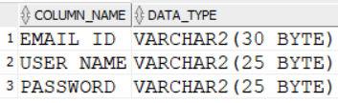
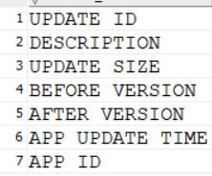
TABLES
Publisher:
downloads:
Updates:
User_table:

Slide 21

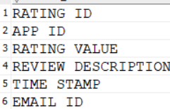
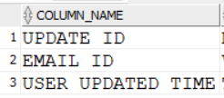
TABLES
wish_list::
Rating_reviews:
user_update:

Slide 22
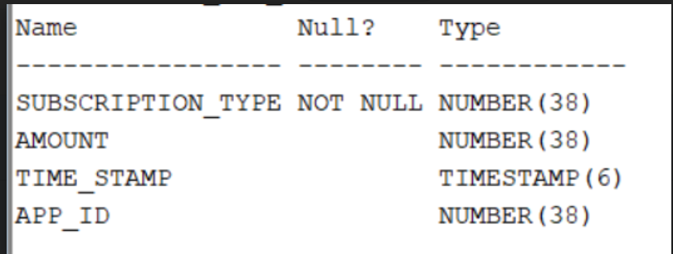
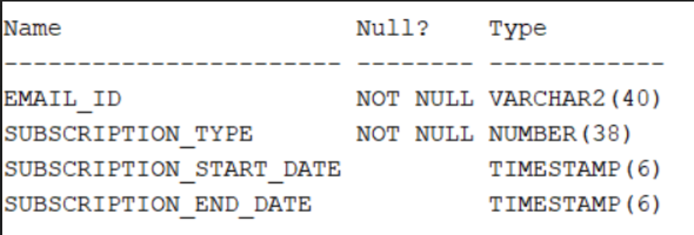
TABLES
PURCHASES
USER_PURCHASE

Slide 23
DATA

Slide 24
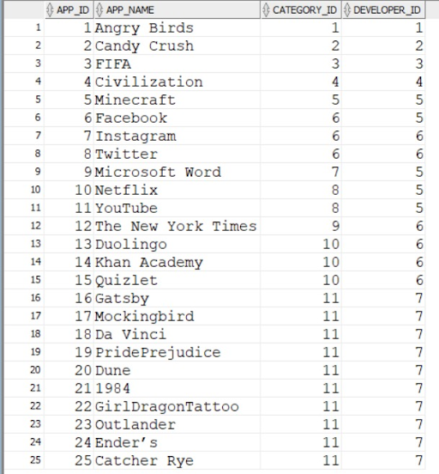
TABLE APPLICATION

Slide 25
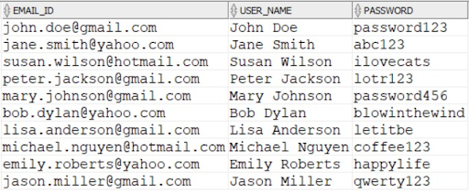
TABLE USER_TABLE

Slide 26

TABLE UPDATES

Slide 27
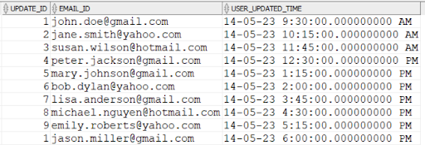
TABLE USER_UPDATE

Slide 28
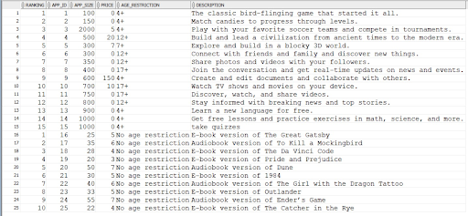
TABLE FEATURES

Slide 29
QUERIES

Slide 30
QUERY 1
Display the book name, author name,
No of pages which are of ‘audio-book’ format.
Code:
select app_name as book_name,author_name,no_of_pages from application,
(select app_id,author_name,no_of_pages from books where genre_id in
(select genre_id from genre where type='Audio-book'))t
where application.app_id=t.app_id;

Slide 31
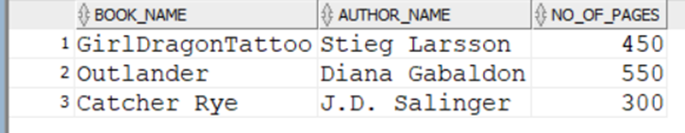
OUTPUT

Slide 32
QUERY 2
Display all the users and their downloaded apps.
CODE:
select user_name,app_name as downloaded_apps from application,
(select user_name,app_id from user_table,downloads where user_table.email_id=downloads.email_id)t
where t.app_id=application.app_id;

Slide 33
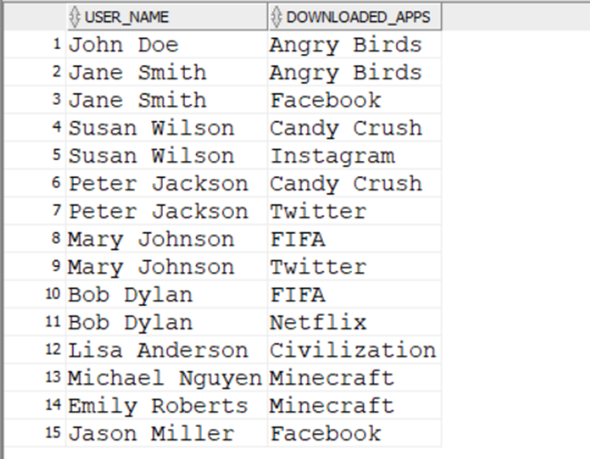
OUTPUT

Slide 34
QUERY 3
Display the details of app(id,name,rating_value,developer) which have received atleast one 5 rating.
CODE:
select f.app_id,f.app_name,developer.developer_id,developer_name from developer, (select application.app_id,app_name,developer_id from application, (select distinct app_id from rating_reviews where rating_value = 5)t where t.app_id=application.app_id)f where f.developer_id=developer.developer_id;

Slide 35
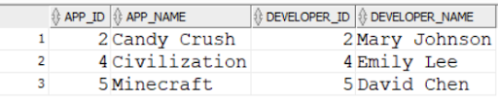
OUTPUT

Slide 36
Thank You

